Slide 1
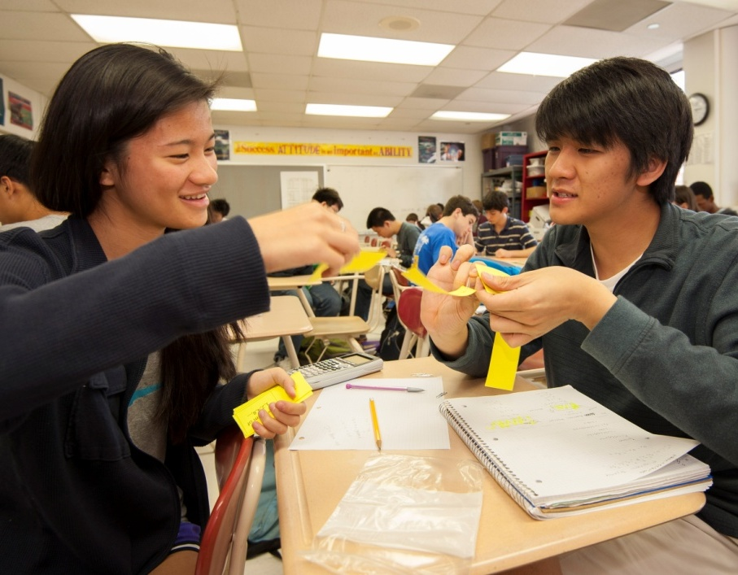
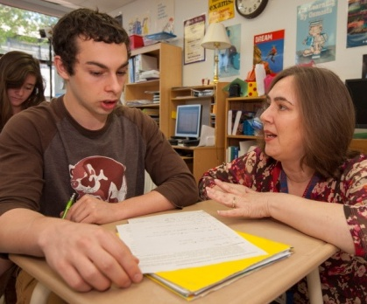
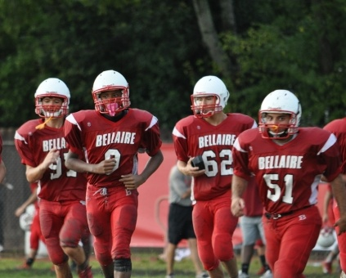
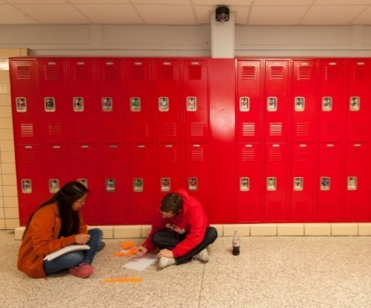
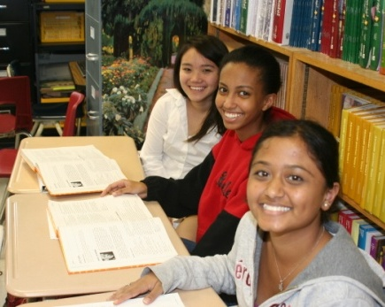
PBK K-12
Bellaire High School Community Meeting Houston Independent School District \\ Bellaire, Texas \\ September 4, 2014
ARCHITECTURE \\ ENGINEERING \\ PLANNING \\ TECHNOLOGY \\ FACILITY CONSULTING
1-800-938-7272 \\ PBK.com

Slide 2
Bellaire High School – Students and Staff
Debra Campbell
Carl Casteel
Marina Finley
Ashley Heng
Joel Leagans
Diana Leeson
Rocky Manuel
Michael McDonough
Amy McIntyre
Andrew Monzon
Bianca Rubio
Allen Scarrow
Tyler Smith
Jay Stubbs
Daniel Wilkes
Zachary Wood
Community Members
Todd Blitzer
Kent Cantrell
Tracy Christie
Rachel Crochet
Sandi Johnson
Judy Long
Leisa Lovy
Swati Narayan
PAT
Project Advisory Team

Slide 3
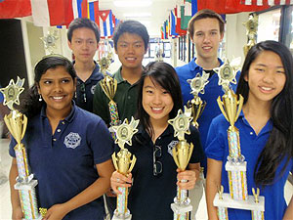
A Culture of Academic Achievement
Atmosphere of shared responsibility
Academic challenge
Intercultural understanding
Mutual respect
An Environment of Academic Excellence
Develop academically, athletically, ethically, physically and socially
Aesthetically pleasing and inspirational
Will maintain or improve upon the quality of existing facilities
Creation of green space
A belief in Collaboration
Encourage collaboration between students, parents, faculty and staff
Environment that supports critical thinking, high achievement, ethical behavior, and respect for intercultural diversity.
Community Involvement for Success
Neighborhood institution offering educational opportunities and hosts community engagements.
Diverse cultures, traditions and customs are celebrated.
Safety Allows for Success
Open visible environment where students, teachers and staff are safe and secure.
Guiding Principles

Slide 4
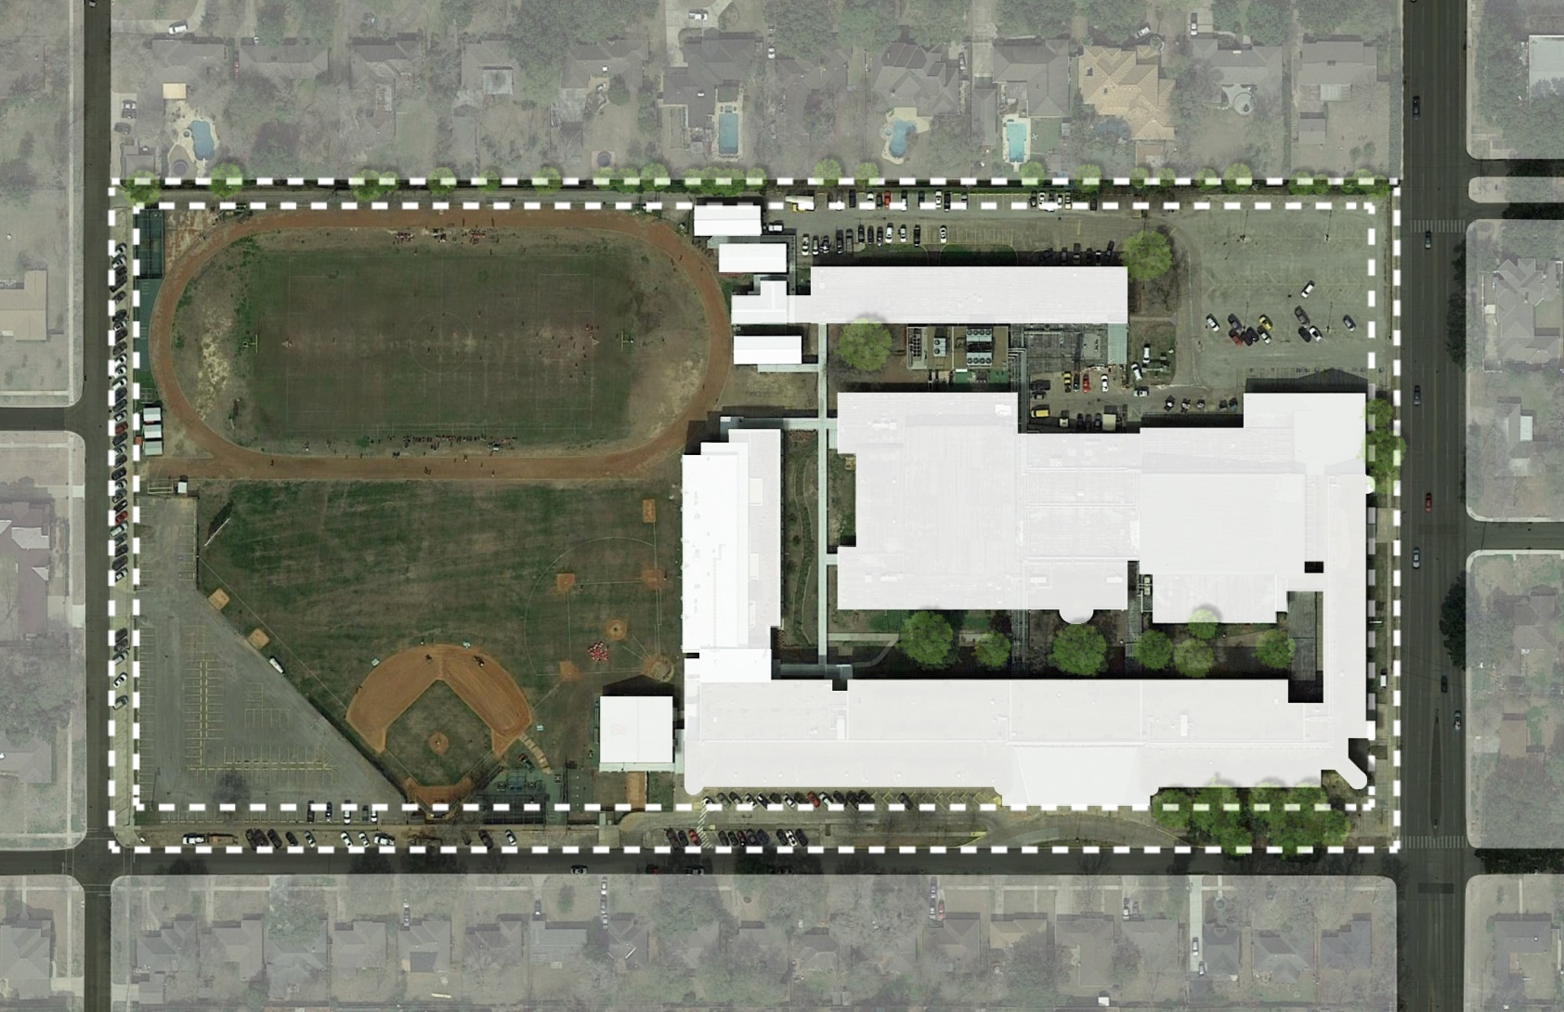
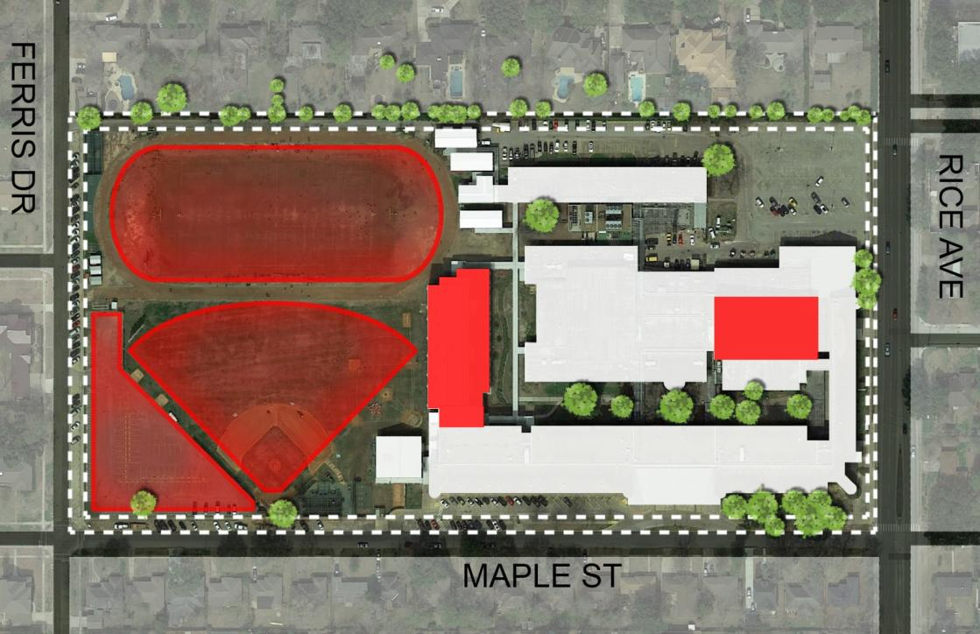
VALERIE ST.
Planning Considerations
Setbacks
Height Requirement
Lot Coverage
Parking Requirement
Traffic
Neighborhood
Detention
S. RICE AVE
FERRIS DR
MAPLE ST
Context
City Site Requirements

Slide 5
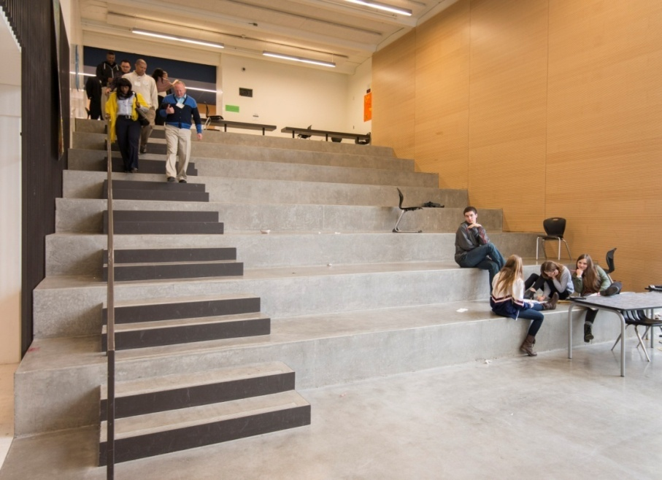
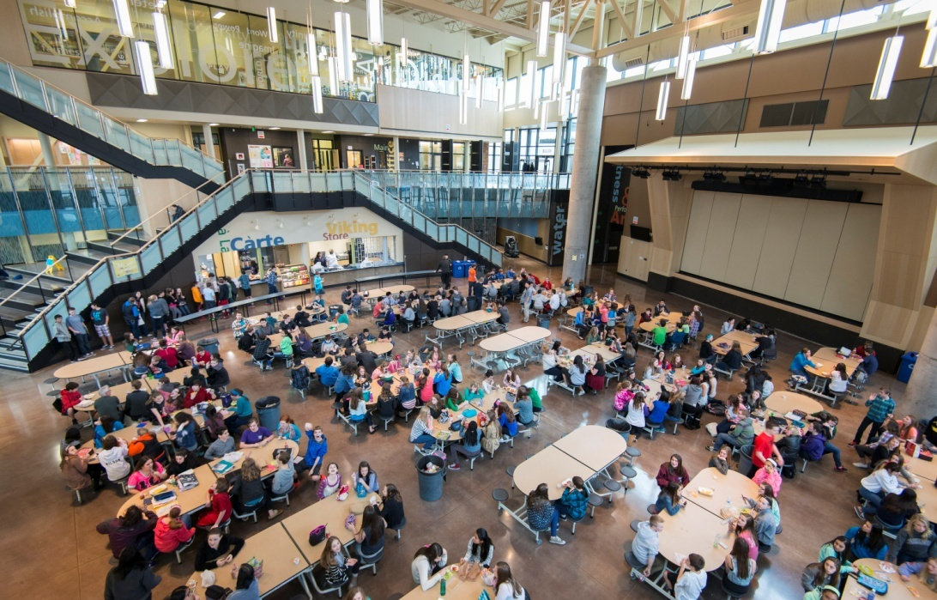
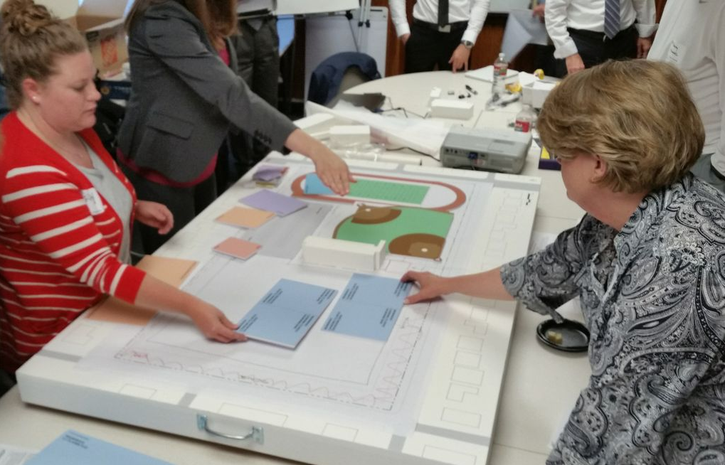

Slide 6
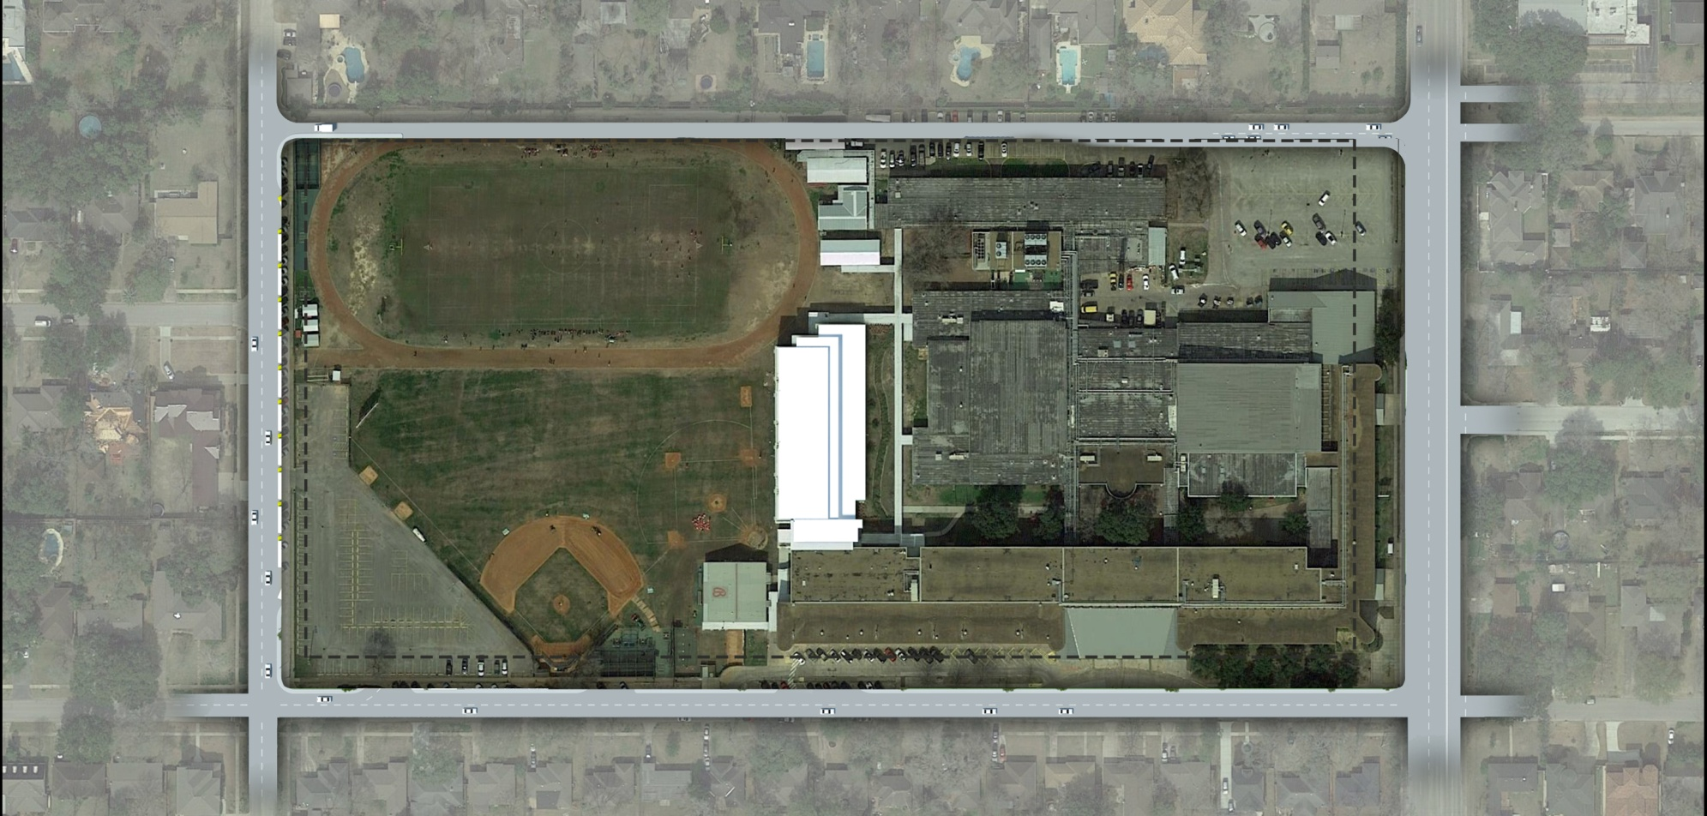
VALERIE ST.
SERVICE LANE
EXISTING
FOOTBALL FIELD AND TRACK
EXISTING
BELLAIRE
HIGH SCHOOL
FERRIS DR.
EXISTING
SCIENCE
BUILDING
S. RICE AVE.
EXISTING
BASEBALL
FIELD
BASEBALL
FIELD
MAPLE ST.
Existing Site Plan
Preliminary designs under development

Slide 7
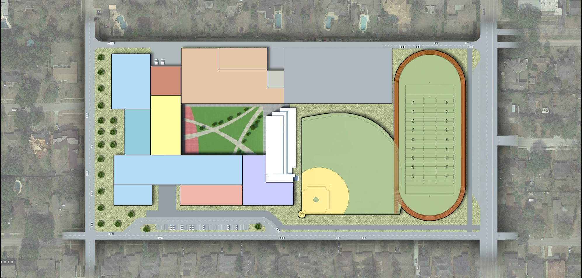
Ferris/Maple Option – Students Remain On-Site During Construction
SERVICE LANE
POOL
MULTI-STORY
CLASSROOM
PHYSICAL EDUCATION ATHLETICS
STUDENT/STAFF
PARKING
CP
KITCHEN
DINING
COMMONS
FERRIS DR.
LEARNING
HUB
COURTYARD
PRACTICE FOOTBALL FIELD AND TRACK
BUS LANES
EXISTING
SCIENCE
BUILDING
PRACTICE
BASEBALL
FIELD
S. RICE AVE.
MULTI-STORY CLASSROOM
ADMINISTRATION
AUDITORIUM/
FINE ARTS
PARENT DROP-OFF
MAPLE ST.
Athletics will be temporarily located at Joe Kelly Butler Sports Complex 5 miles south of campus.
R I S K F A C T O R S
SAFETY
_
STUDENT LIFE
_
CONSTRUCTION SCHEDULE
_
COMMUNITY IMPACT
_
Preliminary designs under development

Slide 8
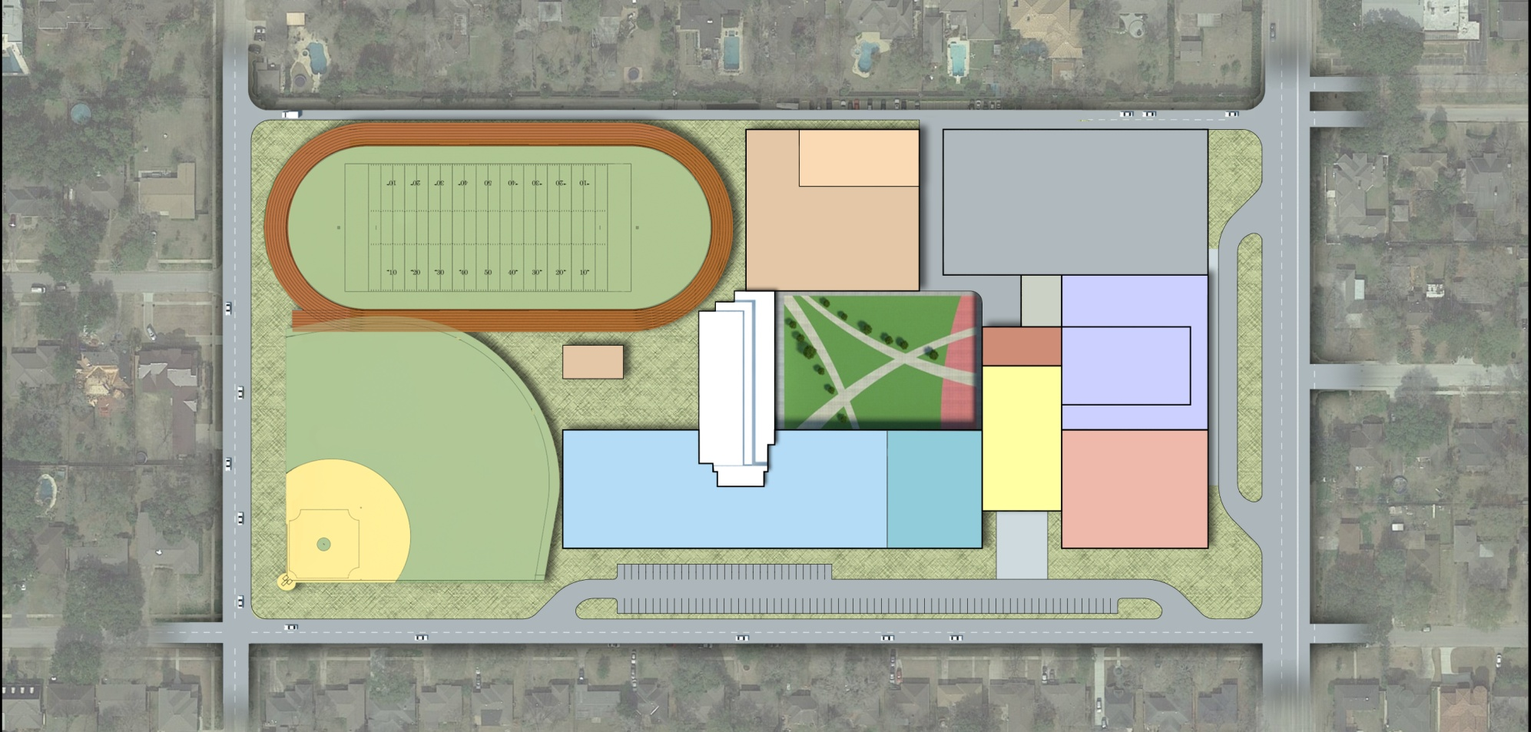
South Rice/Maple Option – Students will be Relocated During Construction
SERVICE LANE
POOL
STUDENT/ STAFF
PARKING
PRACTICE
FOOTBALL FIELD AND TRACK
PHYSICAL EDUCATION ATHLETICS
CP
EXISTING
SCIENCE
BUILDING
COURTYARD
KITCHEN
AUDITORIUM/
FINE ARTS
S. RICE AVE.
FERRIS DR.
BUS LANES
BASEBALL
FIELD
DINING
COMMONS
PRACTICE
BASEBALL
FIELD
LEARNING
HUB
ADMIN
MULTI-STORY
CLASSROOM
PARENT DROP-OFF
MAPLE ST.
R I S K F A C T O R S
SAFETY
_
STUDENT LIFE
_
CONSTRUCTION SCHEDULE
_
COMMUNITY IMPACT
_
Preliminary designs under development

Slide 9
Next Steps

Slide 10
Thank You

